Slide 1
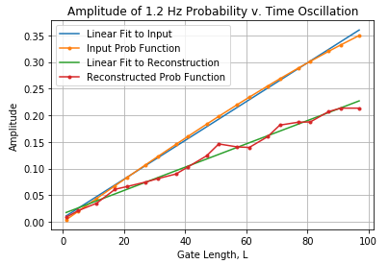
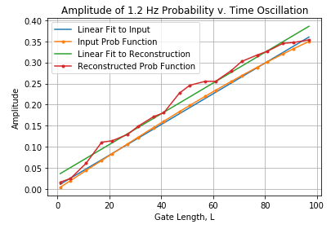
Previous method:
Take the maximum frequency in the vicinity of 1.2 Hz
Make the power for all other frequencies zero
Inverse FT the modified power spectrum
**This tends to underestimate the amplitude of the probability(time) function
New method:
Find the top 2 frequencies within a 0.1 Hz range of 1.2 Hz
Sum those two powers
Associate the summed power with whatever frequency is closest to 1.2 Hz.
Make the power for all other frequencies zero.
Inverse FT the modified power spectrum.
These plots just show the probability amplitude as I varied Gx^L gate length. All parameters are equal between them.
The “new method” appears to follow the input function much better. The slope of the fit lines for the input and reconstructed P(t) are the same.

Slide 2
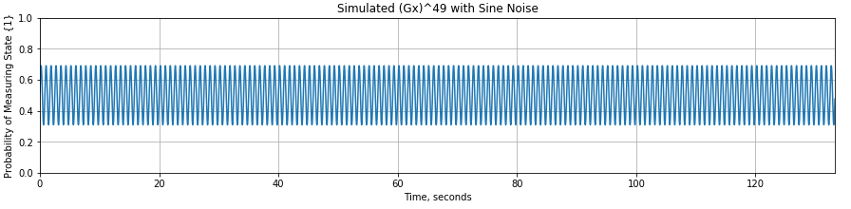
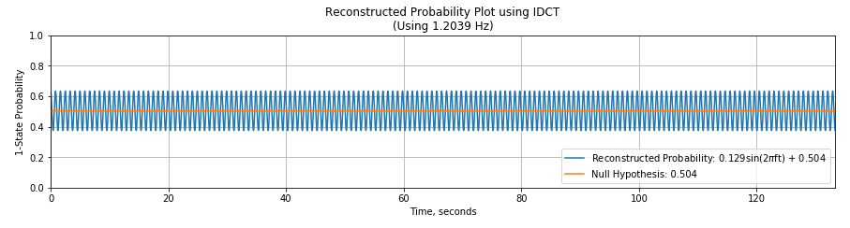
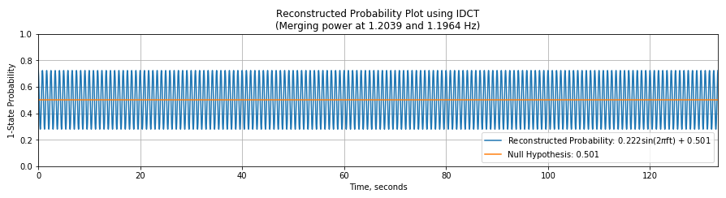
Here’s an example with Gx^49.
Input Amplitude = 0.190
Input P(t) function used to generate data points
Amplitude = 0.129
(0.061 below input)
Old method: Use the frequency with the highest power in the vicinity of 1.2 Hz
Amplitude = 0.222
(0.032 above input)
New Method: Sum the two highest powers, then associate that summed power with the 1.2 Hz bin

Slide 3
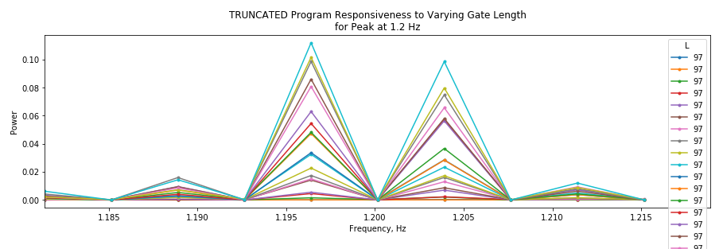
Normalized power spectrum for multiple values of Gx^L
(Truncated to show the 1.2 Hz region)
****Depending on your frequency spacing and whether you start at 0 time, it seems like you may actually get a minimum at 1.2 Hz (or the closest frequency to 1.2), but have maxima adjacent to 1.2 Hz.
This is why just using the top power in the Inverse Transform may not yield an accurate prob(t).

